Slide 1
Overview of SDLC Lifecycle
Day 2

Slide 2
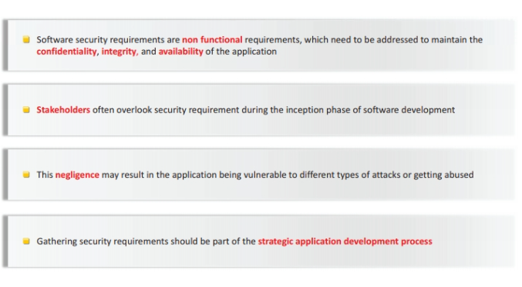
Security Requirements

Slide 3
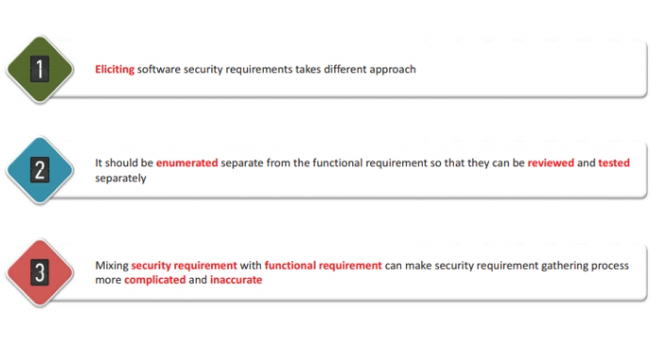
Gathering Security Requirements

Slide 4
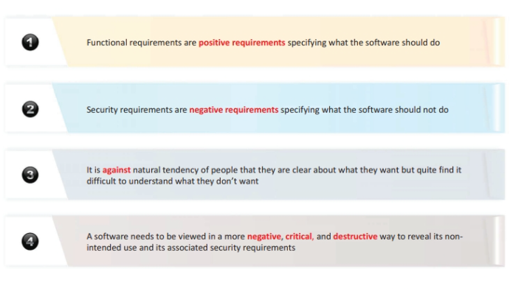
Why we need approach for security requirements gathering

Slide 5
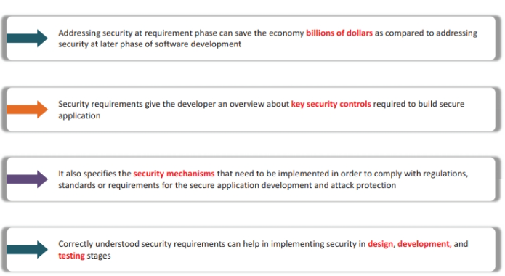
Key benefits of addressing security at requirement phase

Slide 6
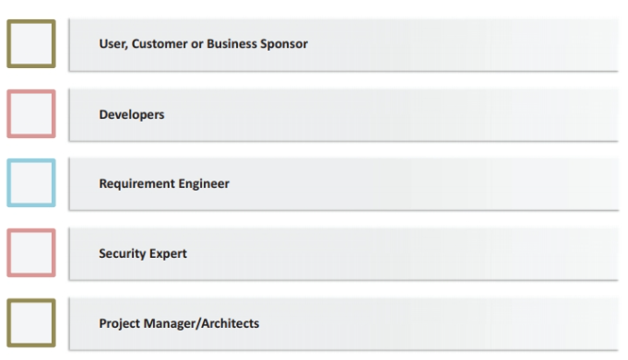
Stakeholders involvement in security requirements gathering

Slide 7
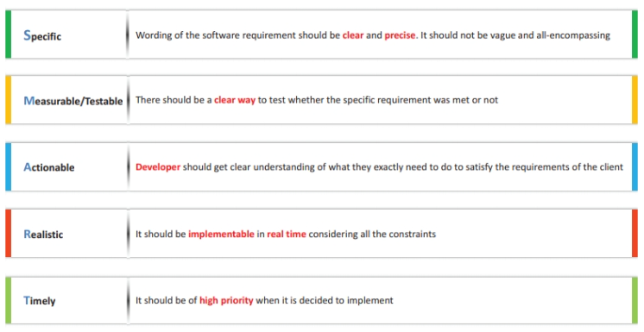
Characteristics of good security requirement: SMART

Slide 8
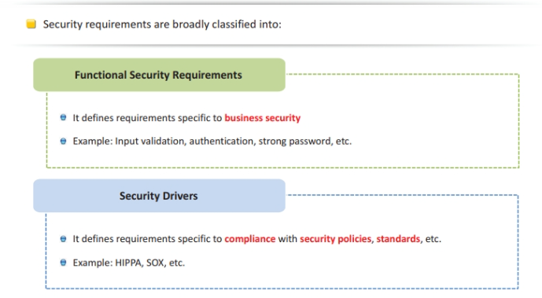
Types of Security Requirements

Slide 9
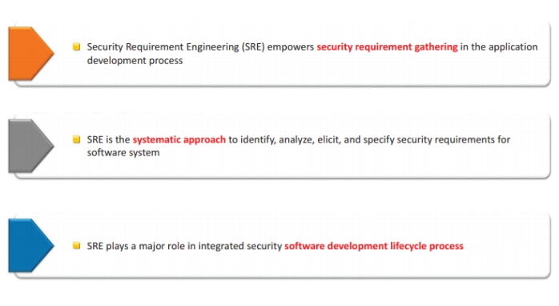
Security Requirement Engineering (SRE)

Slide 10
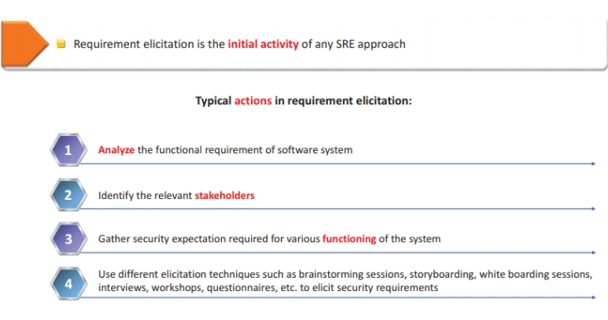
SRE Phases: Security Requirement Elicitation

Slide 11
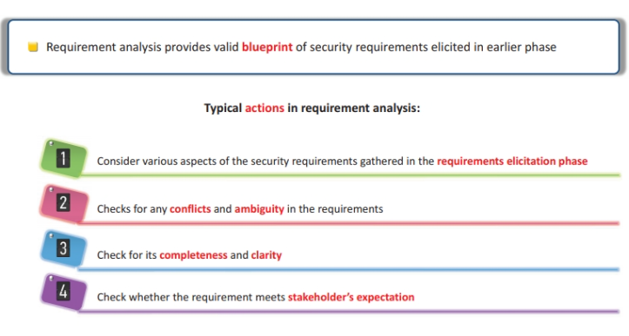
SRE Phases: Security Requirement Analysis

Slide 12
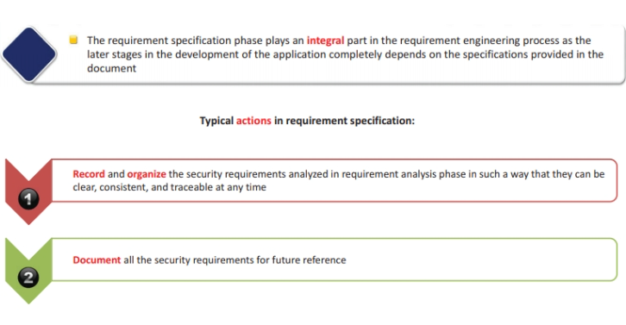
SRE Phases: Security Requirement Specification

Slide 13
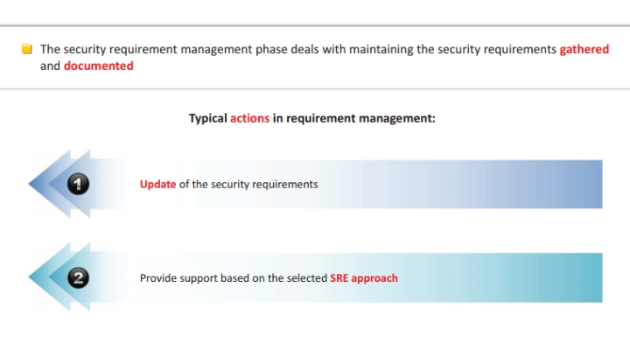
SRE Phases: Security Requirement Management

Slide 14
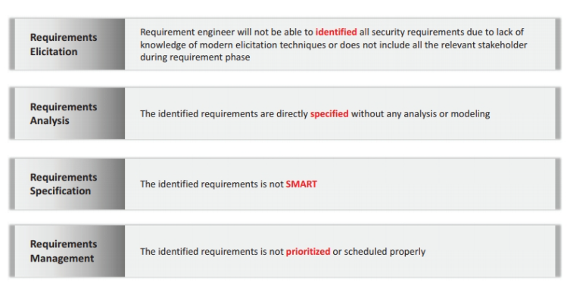
Common Mistakes made in each phase of SRE

Slide 15
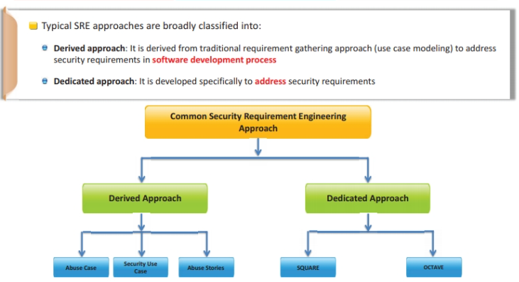
Different Security Requirement Engineering Approaches/Models

Slide 16
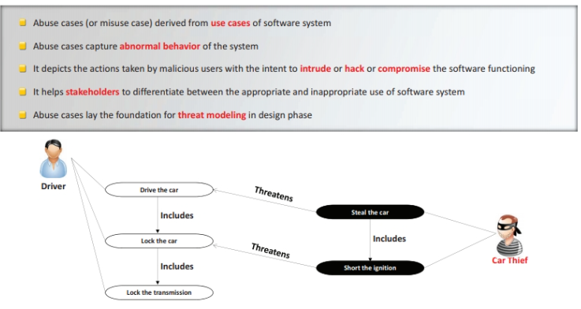
Abuse Cases

Slide 17
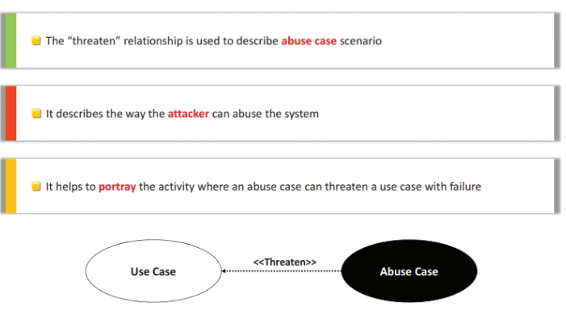
Threatens Relationship

Slide 18
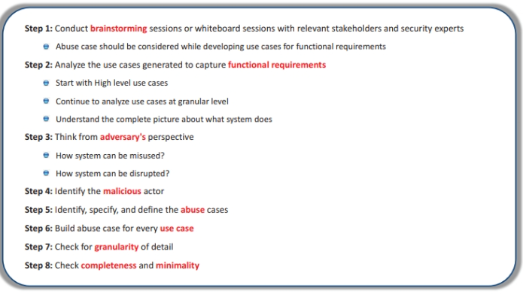
About Case Modelling Steps

Slide 19
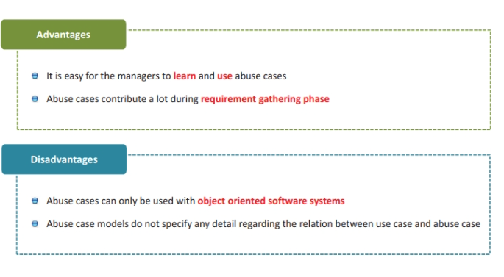
Abuse Cases: Advantages and Disadvantages

Slide 20
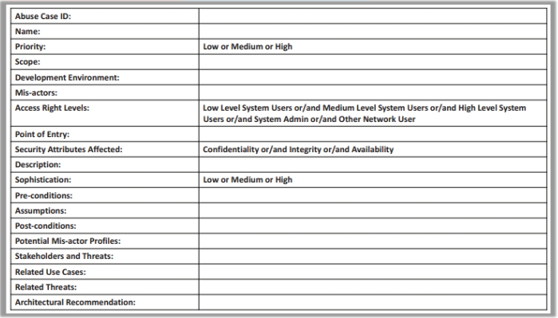
Abuse Case Template

Slide 21
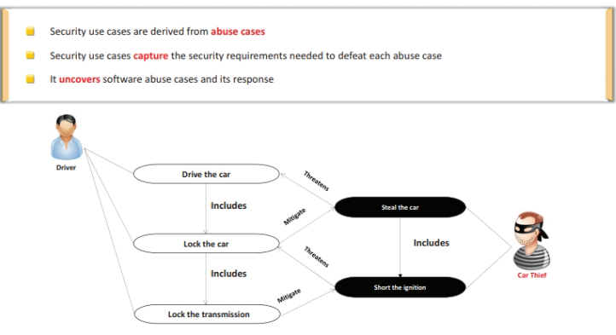
Security Use Cases

Slide 22
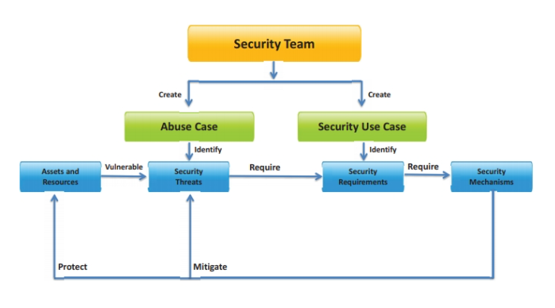
Security Use Cases are Abuse Case Driven

Slide 23
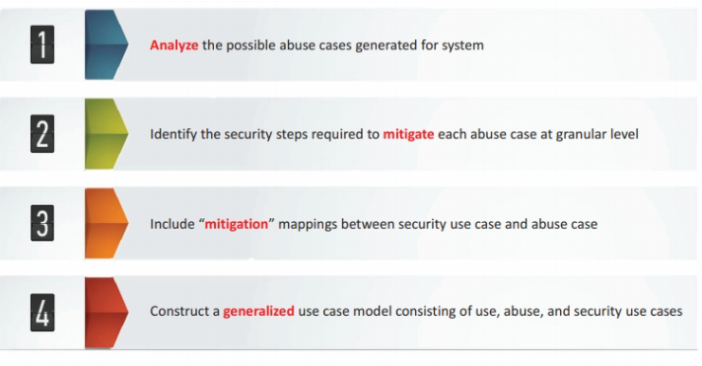
Modelling Steps for Security Use Cases

Slide 24
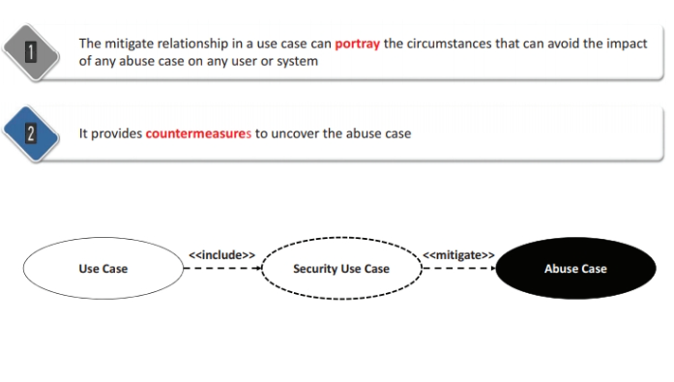
Mitigates Relationship

Slide 25
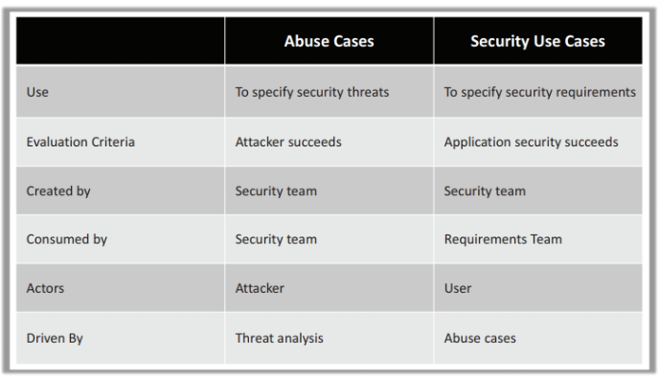
Abuse Use Cases Vs Security Use Cases

Slide 26
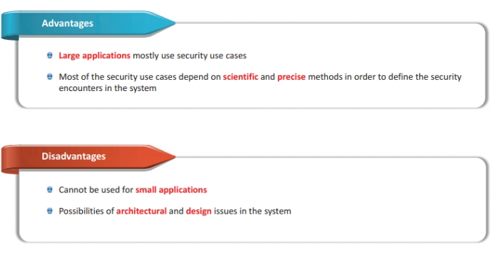
Security Use Case: Advantages and Disadvantages

Slide 27
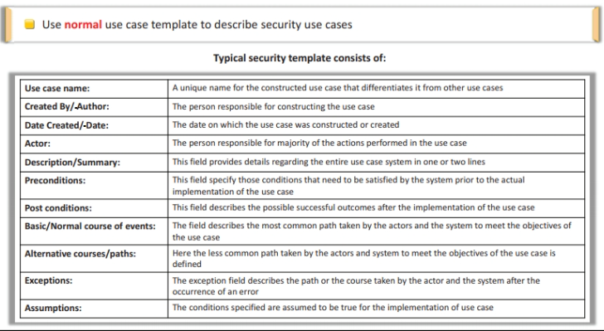
Security Use Case Template

Slide 28
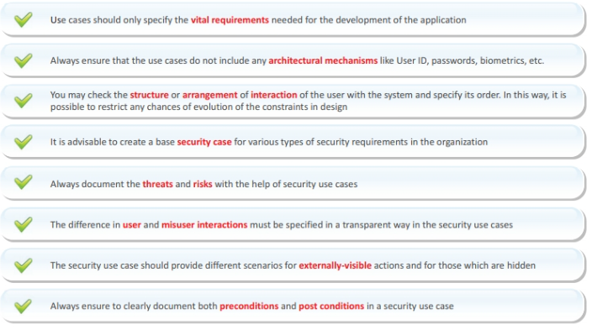
Security Use Case Guidelines

Slide 29
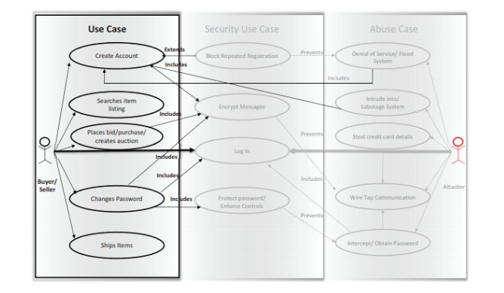
Example 1: Use Case for Online Bidding System

Slide 30
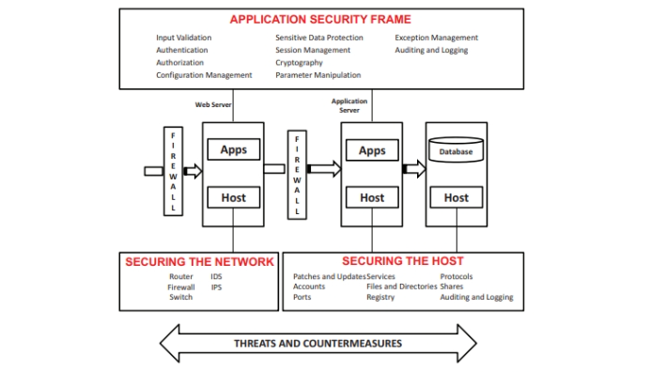
Application Security Frame

Slide 31
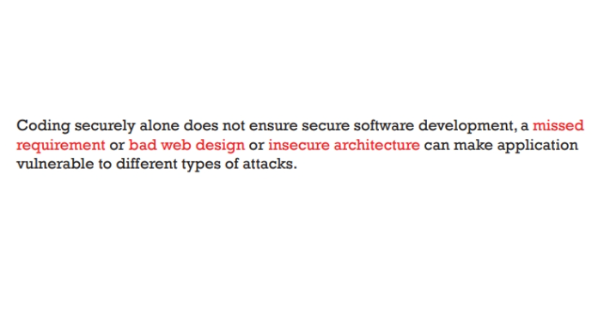

Slide 32
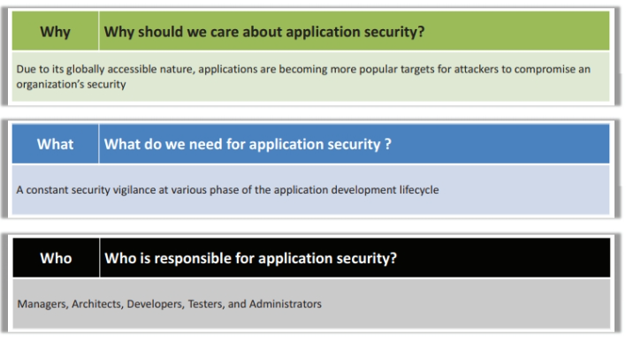
3W’s in Application Security

Slide 33
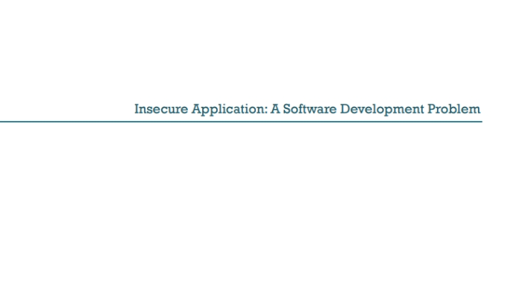

Slide 34
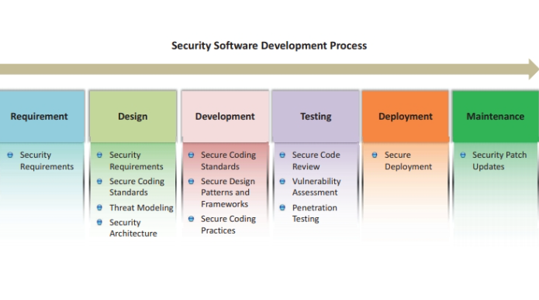
Solution: Integrating Security in Software Development Lifecycle (SDLC)

Slide 35
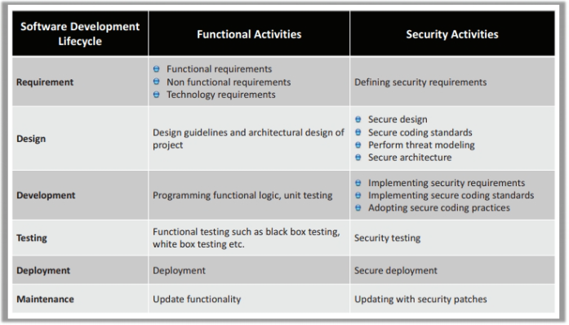
Functional Vs Security Activities in SDLC

Slide 36
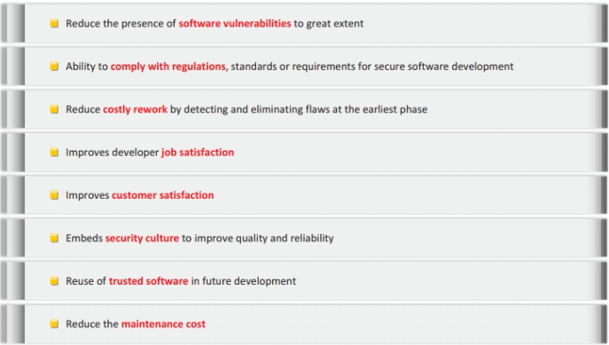
Advantages of Integrating Security in SDLC

Slide 37


Slide 38
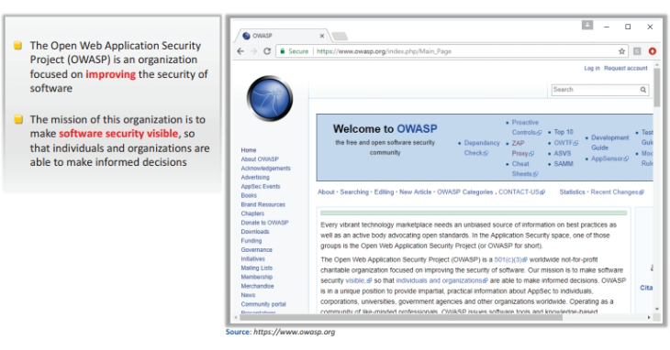
The Open Web Application Security Project (OWASP)

Slide 39
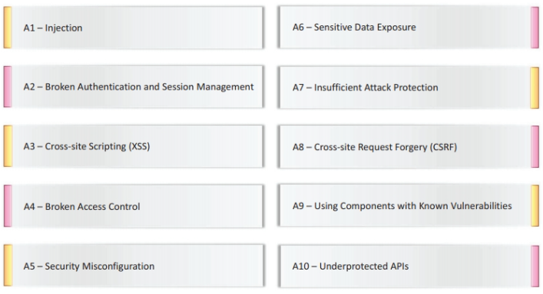
OWASP Top Ten Security Attacks-2017

Slide 40
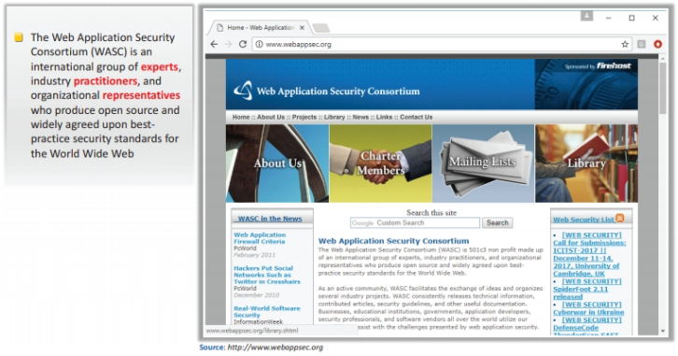
The Web Application Security Consortium (WASC)

Slide 41
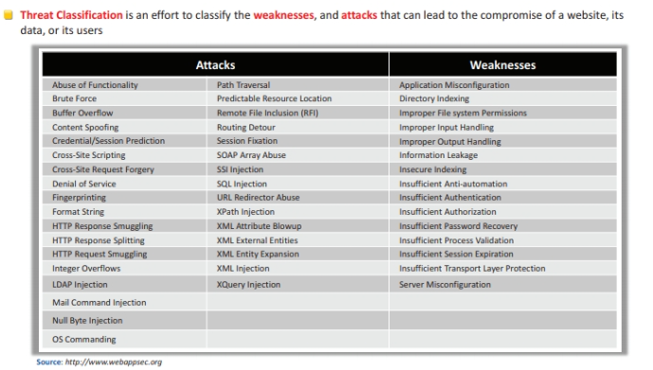
WASC Threat Classification

Slide 42
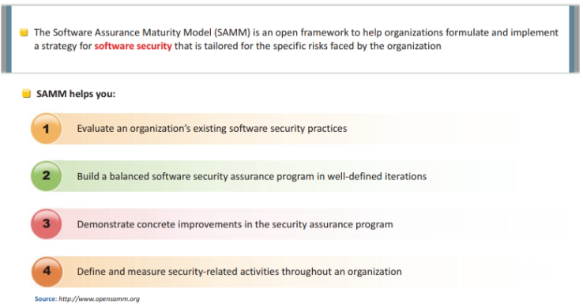
Software Security Framework : Software Assurance Maturity Model (SAMM)

Slide 43
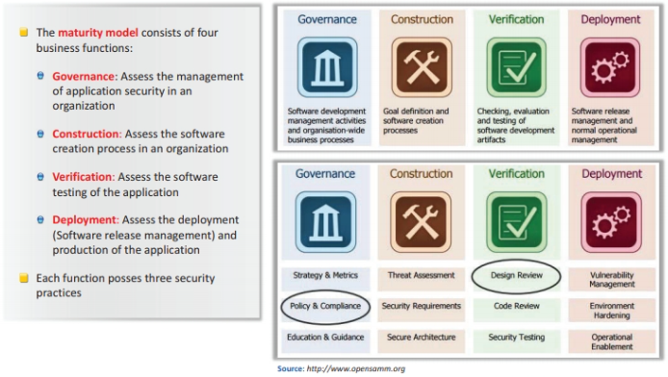
Software Security Framework : Software Assurance Maturity Model (SAMM) (Cont.,)

Slide 44
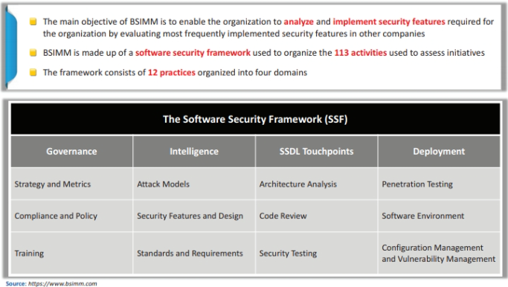
Software Security Framework : Building Security in Maturity Model (BSIMM)

Slide 45
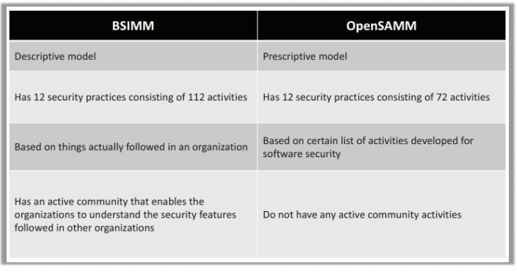
BSIMM Vs OpenSAMM

Slide 46
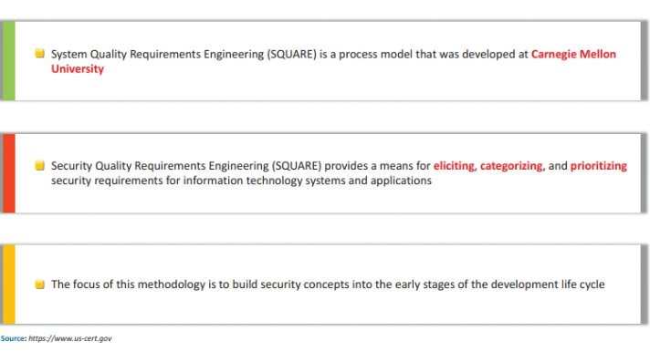
Security Quality Requirements Engineering (SQUARE)

Slide 47
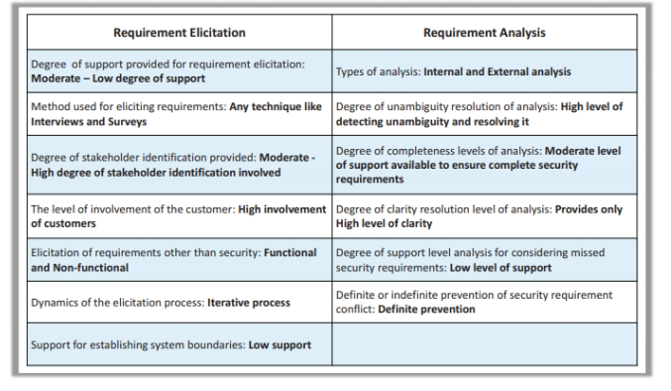
SQUARE Effectiveness

Slide 48
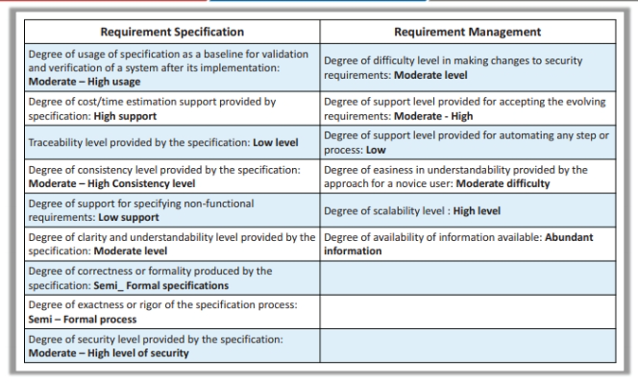
SQUARE Effectiveness (Cont.,)

Slide 49
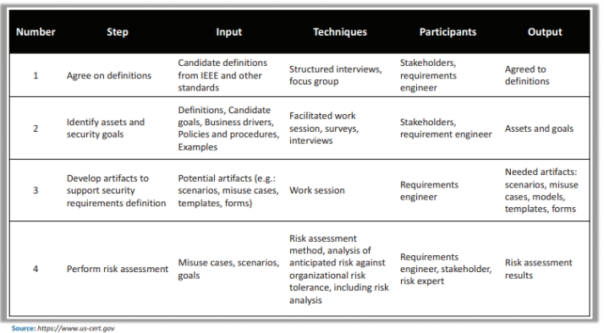
SQUARE Process

Slide 50
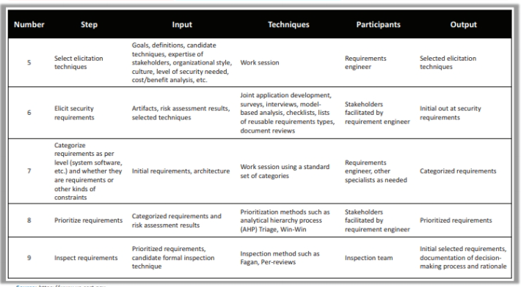
SQUARE Process (Cont.,)

Slide 51
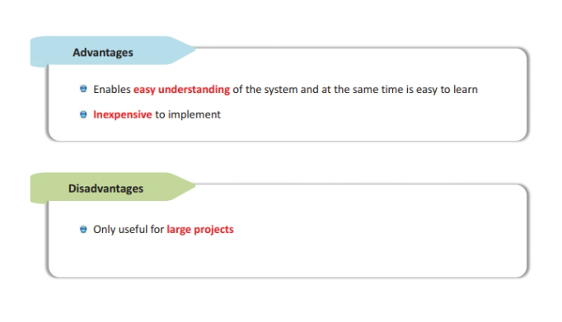
SQUARE: Advantages and Disadvantages

Slide 52
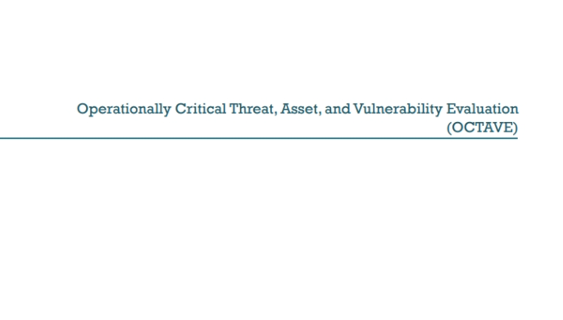

Slide 53

Operationally Critical Threat, Asset, and Vulnerability Evaluation (OCTAVE)

Slide 54

OCTAVE Effectiveness

Slide 55

OCTAVE Effectiveness (Cont.,)

Slide 56

OCTAVE Steps

Slide 57

OCTAVE: Advantages and Disadvantages

